Slide 1
Affect Detection from Text – from Affect Sciences to
Computational Models
Dr. Alexandra Balahur
European Commission Joint Research Centre
alexandra.balahur@jrc.ec.europa.eu
Tutorial held at the 10th edition of the Language Resources and Evaluation Conference, 23-28 May 2016, Portorož (Slovenia)

Slide 2


Slide 3
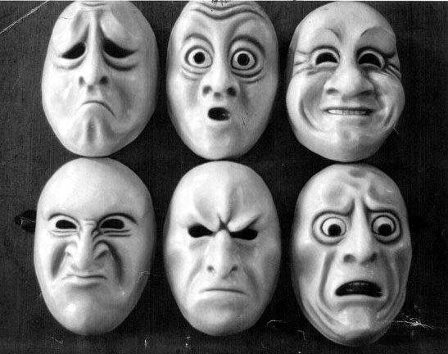
Affect
Mythology
Religions
Spiritual practices
Placebo effect
“New Age” theories
Feminism/femininity
“Positive Psychology”

Slide 4


Slide 5
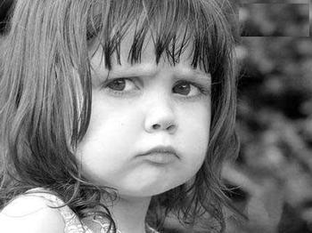

Slide 6


Slide 7


Slide 8


Slide 9


Slide 10
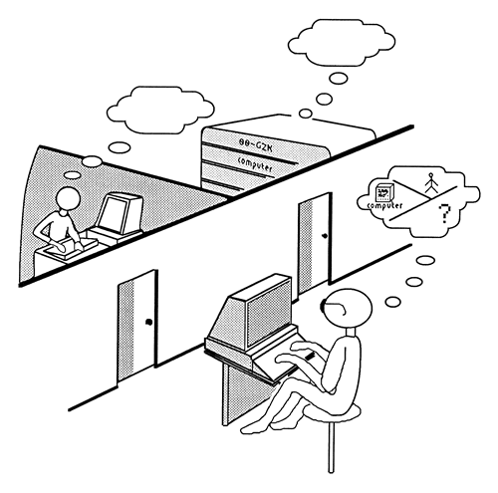
Turing Test & AI
1950s – Alan Turing
-> 1956 - Birth of AI
1637 – René Descartes
  Machines that can
  “utter words”, “reply”
1937 – Alfred Ayer
  “conscious” vs. “unconscious”

Slide 11

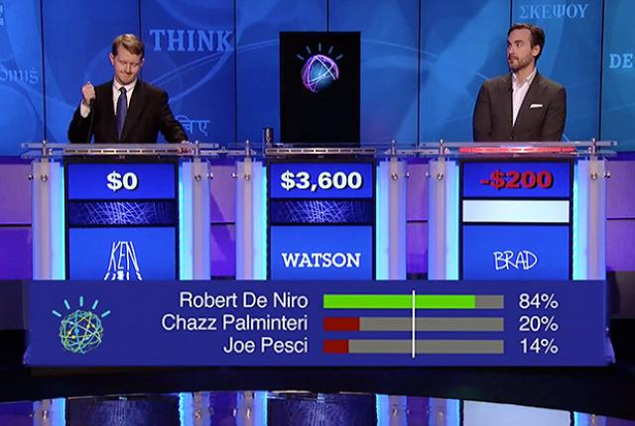
Turing Test & AI
Knowledge about the world, past experiences, reasoning based on information, etc.

Slide 12
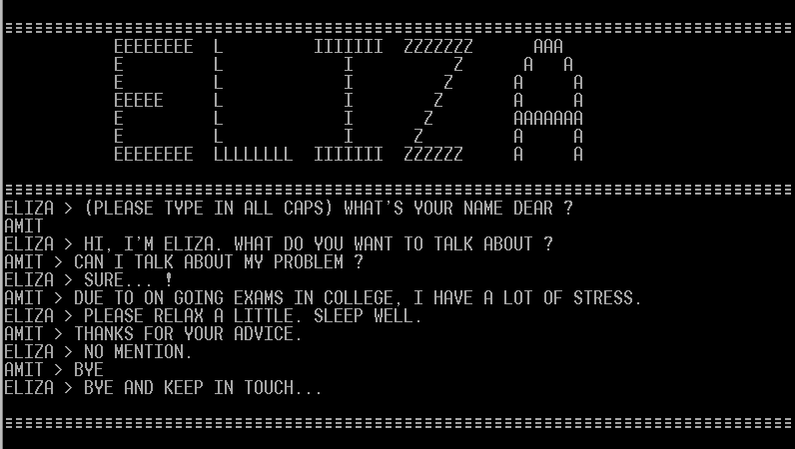
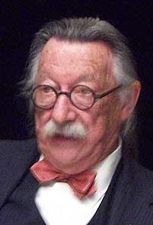
Joseph Weizenbaum – 1954, MIT

Slide 13
Overview
Emotion and other “related” concepts
Emotion and cognition
  IQ and emotional “intelligence”
Affect theories in Psychology
  main theories on emotion, main models of emotion
Affect theories in Cognitive Science
Theories on affect in Neurosciences
Affective Computing and AI
  Emotion detection methods
  Applications – virtual worlds, Robotics, …
Affect detection and classification in NLP
  Subjectivity analysis
  Sentiment analysis
  Emotion detection
  Open competitions and state of the art results
  Applications

Slide 14
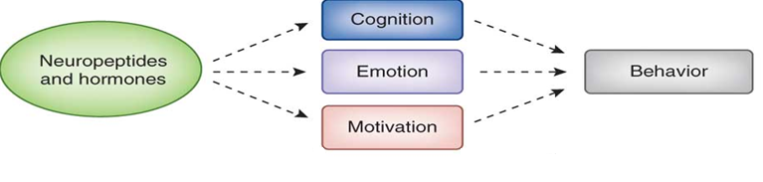
From Cade McCall & Tania Singer - “The animal and human neuroendocrinology of social cognition, motivation and behavior” - Nature Neuroscience 15, 681–688 (2012)
http://www.ncbi.nlm.nih.gov/pubmed/22504348

Slide 15
Affect, emotion, related concepts (I)
Affect
  “a superordinate concept that subsums particular valenced conditions such as emotions, moods, feelings and preferences” (Ortony et al., 2005)
  one of the four components whose interaction make the human organism “function effectively in the world” (Ortony et al., 2005), along with motivation, cognition and behaviour.

Slide 16
Affect, emotion, related concepts (II)
Emotion
  complex phenomenon, on which no definition that is generally accepted has been given;
  “An episode of interrelated, synchronized changes in the states of all or most of the five organismic subsystems (Information processing, Support, Executive, Action, Monitor) in response to the evaluation of an external or internal stimulus event as relevant to major concerns of the organism”. (Scherer, 1987; Scherer, 2001).

Slide 17
Affect, emotion, related concepts (III)
Feeling
  “The conscious subjective experience of emotion.“ (Van den Bos, 2006)
  “(…) points to a single component of emotion, denoting the subjective experience process, and is therefore only a small part of an emotion” (Scherer, 2005)

Slide 18
Affect, emotion, related concepts (IV)
Sentiment
  “suggests a settled opinion reflective of one’s feelings.”

Slide 19
Affect, emotion, related concepts (V)
Opinion
  implies a conclusion thought out yet open to dispute; it is:
  A): a view, judgment, or appraisal formed in the mind about a particular matter; B): approval, esteem;
  A): a belief stronger than impression and less strong than positive knowledge; B): a generally held view;
  A): a formal expression of judgment or advice by an expert; B): the formal expression (as by a judge, court, or referee) of the legal reasons and principles upon which a legal decision is based.

Slide 20
Affect, emotion, related concepts (VI)
View
  suggests a subjective opinion.
Belief
  implies often deliberate acceptance and intellectual assent.
Conviction
  applies to a firmly and seriously held belief.
Persuasion
  suggests a belief grounded on assurance (as by evidence) of its truth.

Slide 21
Affect, emotion, related concepts (VII)
Attitude
  “hypothetical construct that represents an individual's degree of like or dislike for something.” (Breckler and Wiggins, 1992)
  generally positive or negative views of a person, place, thing, or event— this is often referred to as the attitude object.
  Attitudes are judgments.

Slide 22
Affect, emotion, related concepts (VII)
Attitude
  develops on the ABC model (affect, behavior, and cognition).
    The affective response is an emotional response that expresses an individual's degree of preference for an entity.
    The behavioral intention is a verbal indication or typical behavioral tendency of an individual.
    The cognitive response is a cognitive evaluation of the entity that constitutes an individual's beliefs about the object.
  result of either direct experience or observational learning from the environment

Slide 23
Emotion and cognition (I)
Often seen separately (Zajonc, 1980)
Now good evidence that emotion is an integral attribute of cognition (Adolphs and Damasio, 2001)
Emotion modulates information processing – from memory to reasoning to decision making
Emotion considered also “cognitive” – since it is a computation over representations of the organism’s body states
  Confirmed by studies in neuropshysiology, neuropsychology
Affective representations map the relationship between current/future body states and past/baseline states
  With respect to how such changes affect the organism’s survival and well-being

Slide 24
Emotion and cognition (II)
“Anger towards another individual” example:
  Multiple neural mappings
    Comprehensive representation of external stimulus
    The body’s own state
    Relationship between the two
  Unfolding in parallel in time
  Some based on declarative knowledge and reasoning
  Several different sets of emotional responses are triggered by stimulus, resulting in dynamic change in:
      Somatosensory state of body
      Somatovisceral function
      Endocrine and neuroendocrine function
      Autonomic tone
      Global brain functioning
Maximize successful behavior

Slide 25
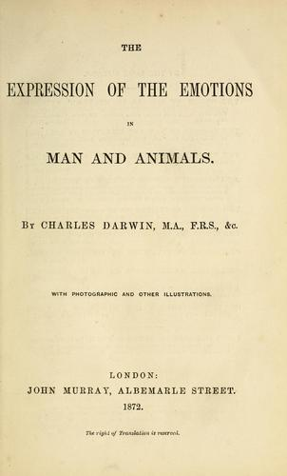
Affect theories in Psychology (I)
Charles Darwin
evolution of emotions – species (animals, humans)
defended the argument that emotion expressions are evolved and adaptive (at least at some point in the past) and serve an important communicative function (Hess and Thibault, 2009)
Why emotions are expressed the way they are:
  principle of serviceable habits
  principle of antithesis
  principle of the direct action of the excited nervous system on the body

Slide 26
Affect theories in Psychology (II)
James–Lange Theory (William James, Carl Lange)
The autonomic nervous system creates physiological events, as a response to experiences in the world, e.g.:
  muscular tension
  a rise in heart rate
  perspiration
  dryness of the mouth
Emotions are feelings which come about as a result of these physiological changes, rather than being their cause.

Slide 27
Affect theories in Psychology (III)
Silvan Tomkins - “Affect Theory”
introduced the concept of basic emotions
based on the idea that the dominance of the emotion, which he called the affected system was the motivating force in human life
organizes affects (i.e., emotions, or subjectively experienced feelings) into discrete categories
connects each affect with its typical response
"biological portion of emotion“ - "hard-wired, preprogrammed, genetically transmitted mechanisms that exist in each of us", which, when triggered, precipitate a "known pattern of biological events"

Slide 28
Affect theories in Psychology (IV)
Silvan Tomkins - “Affect Theory” (1991)
Positive:
  Enjoyment/Joy (reaction to success / impulse to share) — smiling, lips wide and out
  Interest/Excitement (reaction to new situation / impulse to attend) — eyebrows down, eyes tracking, eyes looking, closer listening
Neutral:
  Surprise/Startle (reaction to sudden change / resets impulses)— eyebrows up, eyes blinking

Slide 29
Affect theories in Psychology (V)
Silvan Tomkins - “Affect Theory”
Negative:
  Anger/Rage (reaction to threat / impulse to attack) — frowning, a clenched jaw, a red face
  Disgust (reaction to bad taste / impulse to discard) — the lower lip raised and protruded, head forward and down
  Dissmell (reaction to bad smell / impulse to avoid - similar to distaste) — upper lip raised, head pulled back
  Distress/Anguish (reaction to loss / impulse to mourn) — crying, rhythmic sobbing, arched eyebrows, mouth lowered
  Fear/Terror (reaction to danger / impulse to run or hide) — a frozen stare, a pale face, coldness, sweat, erect hair
  Shame/Humiliation (reaction to failure / impulse to review behaviour) — eyes lowered, the head down and verted, blushing

Slide 30
Affect theories in Psychology (VI)
Magda B. Arnold - Appraisal Theory
Emotions are extracted from our evaluations (appraisals) of events
  causing specific reactions in different people
Appraisal of a situation causes an emotional, or affective, response that is going to be based on that appraisal.
Accounts for individual variances of emotional reactions to the same event
Two approaches:
    Structural approach
    Process model
  Explaining how emotions develop:
    Event->Thinking ->simultaneous events of Arousal and Emotion

Slide 31
Affect theories in Psychology (VII)
Richard Lazarus - Appraisal Theory – Structural Model
Biopsychological components of the theory
Cognitive aspects of emotion:
  nature of the cognitions (or appraisals) which underlie separate emotional reactions
  determining antecedent conditions of these cognitions
Two major types of appraisal methods :
  1) primary appraisal - establishment of the significance or meaning of the event to the organism
  2) secondary appraisal - assessment of the ability of the organism to cope with the consequences of the event
Critiqued for lack of coping with dynamic nature of emotions

Slide 32
Affect theories in Psychology (VIII)
Smith and Kirby; Marsella and Gratch - Appraisal Theory – Process Model
How one evaluates emotional stimuli
Three main components to the process model of appraisal:
  Perceptual stimuli (what you pick up from surroundings)
  Associative processing (memory-based process -> quick connections and provides appraisal information based on activated memories that are quickly associated with the given stimulus)
  Reasoning (slower, deliberate, thorough involving logical, critical thinking about the stimulus and/or situation)

Slide 33
Affect theories in Psychology (IX)
Klaus Scherer - Appraisal Theory – Process Model - Multi-level Sequential Check Model
Three levels of appraisal process + sequential constraints
  innate (sensory-motor)
  learned (schema-based)
  deliberate (conceptual)
Strict, ordered progression for appraisal processes
Checks at all levels:
  Relevance (novelty and relevance to goals) check
  Implication check (cause, goal conduciveness, and urgency)
  Coping potential check (control and power)
  Normative significance (compatibility with one’s standards)

Slide 34
Affect theories in Psychology (X)
Social constructivism
Takes into account the social context in which emotions develop
“It is important to map the properties of the specific interactions, the structure of the relationships, and the organization of the culture in which the individual engages” (Boiger & Mesquita, 2012)
“Emotions that fit the predominant cultural goals tend to be rewarded, and are then found to become more prevalent” (Mesquita, 2003)
“Social construction of emotion is an iterative, or even continuous, process that draws on information, events, and interactions within the actual social and cultural environment, rather than solely relying on internal representations in the head of the individual” (Boiger & Mesquita, 2012)
Complementary to individual predispositions, not contradicting

Slide 35
Affect theories in Neuroscience
Affective neuroscience
The Study of the neural mechanisms of emotion – personality, emotion, mood
Emotions related to brain activity
  Attention
  Behaviour
  Significance
Pioneering work suggested emotion is related to limbic system (amygdala, hypotallamus, etc.)
In practice, not only limbic system of significance, but also other regions: cerebellum, pre-frontal cortex, etc.

Slide 36
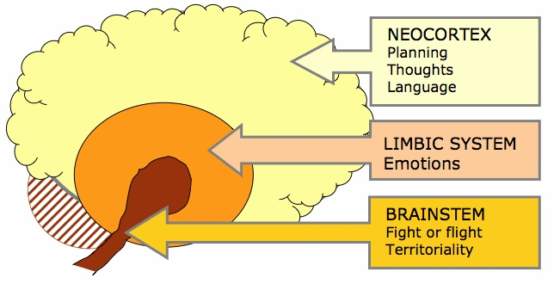
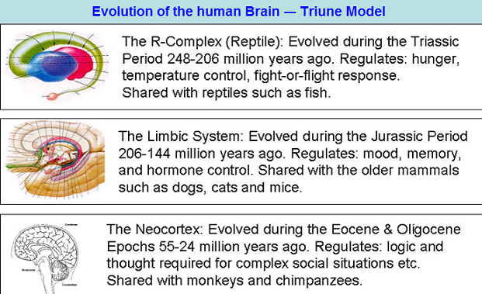
Affect theories in Neuropsychology
The Triune Brain (Paul D. MacLean) – 1950s

Slide 37
IQ and emotional intelligence (EQ)
Daniel Goleman – Emotional Intelligence (1995) – pp. 43
EQ describes an ability, capacity, or skill to perceive, assess, and manage the emotions of one's self and others.
Knowing one’s emotions
  self-awareness – recognizing a feeling as it happens, monitor
Managing emotions
  handling feelings, being able to correctly assign them to the cause, soothe oneself
Motivating oneself
  marshaling emotions in the service of a goal, emotional self control, delaying gratification, stifling impulsiveness
Recognizing emotions in others (empathy)
Handling relationships
  Managing emotions in others – leadership, popularity

Slide 38
Gender and emotion
1) “Gender and Emotion: An Interdisciplinary Perspective” (2013)- Editors Ioana Latu, Marianne Schmid Mast, Susanne Kaiser
2) http://www.ncbi.nlm.nih.gov/pubmed/22504348
Women express more emotion than men.
Do they also experience more emotion than men?
Are emotions represented differently in men and women’s brains?
What are the origins of gender differences in emotions – are we born different or is it socialization that renders us different?
What are the implications of gender differences in emotion for general well-being?
What are the most appropriate methodologies for the empirical study of gender differences in emotional experiences?

Slide 39
Culture and emotion
Individualistic versus collectivistic cultures
Individualistic cultures
  Emotions are “encouraged”, being a manner of self-expression
  Emotion expression and “owning” emotions
Collectivistic cultures
  Emotions stem from the outside (?)
  Low self-disclosure
  Suppression of emotion for fear of community harmony loss
    Emotion rackets (learned feelings; transformed feelings) – Transactional Analysis
Certain emotions are encouraged and others discouraged depending on culture

Slide 40
Language and emotion
Certain languages put more emphasis on some emotions
  Many more words to express the “same” emotion
  No equivalence to emotions expressed in certain languages (saudade (PT), dor (RO), Schadenfreude (DE), etc.)
The manner in which emotions are expressed in language conditions the way in which they are perceived
Identifying and labeling through language the emotion felt can help to relieve it
Can emotions be translated?
  Studies on the translation of the Bible

Slide 41
Personality and emotion (I)
Personality
“coherent patterning of affect, behavior, cognition and goals (desires) over time and space” (Revelle and Scherer, 2008)
Different models of personality proposed, across 3-5 dimensions:
  Giant Three (Eyseneck and Eyseneck, 1985)
  Big Five (Digman, 1990)
  4 dimensions - Myers-Briggs (based on Carl Jung’s archetypes)
Two of these dimensions associated to individual differences in affective level and environmental responsivity (Ravelle, 1995)
  Extraversion
  Neuroticism (Emotional Stability)

Slide 42
Personality and emotion (II)
Traits:
  Anger
  Anxiety
  Positive-negative affect
Habitual emotion dispositions – shield against certain emotions:
  Extraversion
    General positive outlook ; need for social contact, power, status
  Neuroticism
    General negative outlook; need for acceptance, tranquility, order, vengeance, savings
Origins:
  Innate/learned through learning and socialization
Appraisal style:
  Some personalities more prone to certain emotions, b/c differences in goals, values, coping potential

Slide 43
Cognitive biases
Long list of biases:
  https://en.wikipedia.org/wiki/List_of_cognitive_biases
  David McRaney (2012) - “You are not so smart”
  Anchoring bias – tendency to focus on the first piece of information we receive
  Availability cascade bias– the more you repeat something, the more true it becomes
  Confirmation bias - tendency to search for, interpret, focus on and remember information in a way that confirms one's preconceptions
  Hindsight bias – “I knew it all along” – tendency to see the events that past as having been predictable
  Gambler’s fallacy - future probabilities are altered by past events, when in reality they are unchanged.

Slide 44
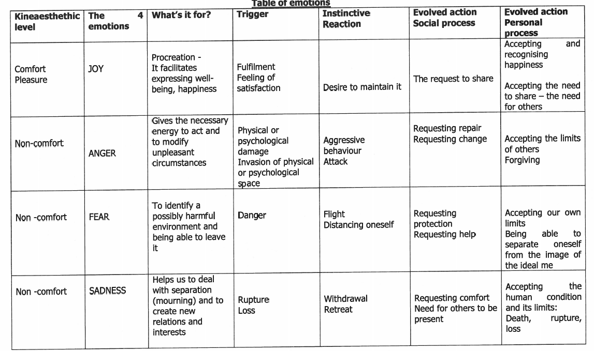
Roles of emotions
From MBTI – emotion overview

Slide 45
Models of emotion (I)
Two types:
  Categorical – a certain number of limited emotion “categories” are defined
  Dimensional – organized in affective dimensions
    Valence-pleasantness + activity-arousal (Russell)
    Semantic differentials (Osgood)
    Three-dimensional model based on levels of presence of hormones (Lövheim)

Slide 46
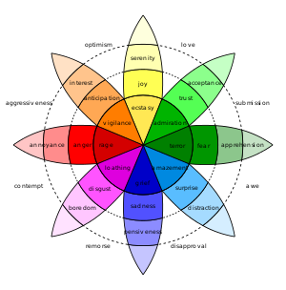
Models of emotion (II)
Categorical models of emotion:
Ekman (facial expressions):
6 basic emotions: joy, anger, fear, sadness, disgust, surprise
Plutchik’s “Wheel of emotions”:
8 basic emotions
8 derivative emotions, combination of basic ones
Shaver (1987)/Parrot (2001) Tree-structured list of emotions:
6 basic emotions (instead of disgust, love)
Secondary and tertiary emotions

Slide 47
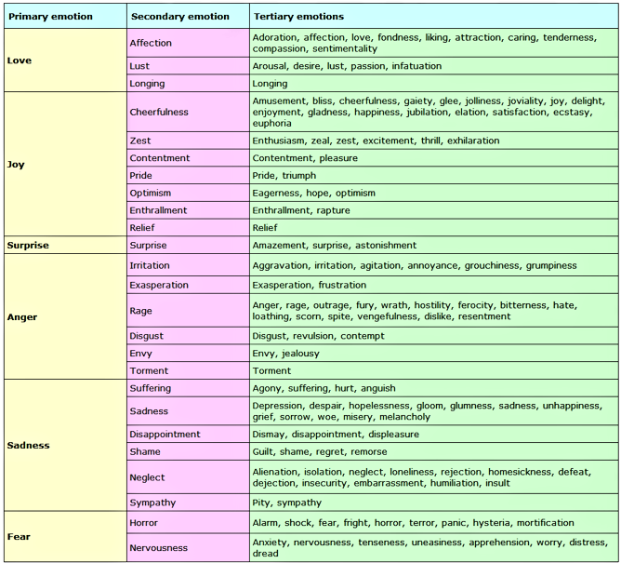
Models of emotion (III)

Slide 48
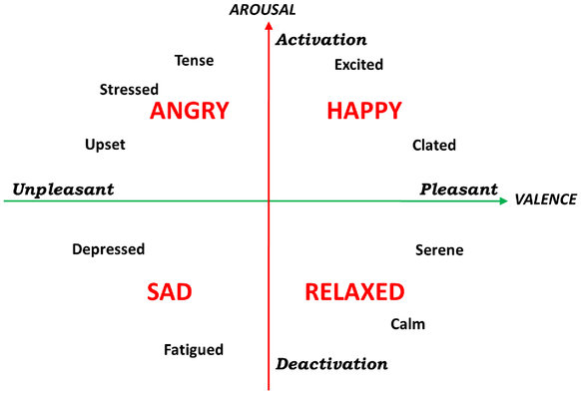
Models of emotion (IV)
Dimensional models of emotion:
    Valence/pleasantness + activity/arousal (Russell, 1980)

Slide 49
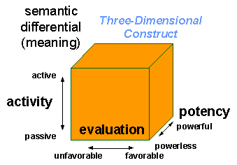
Models of emotion (V)
Dimensional models of emotion:
    Semantic differentials (Osgood, 1957)

Slide 50
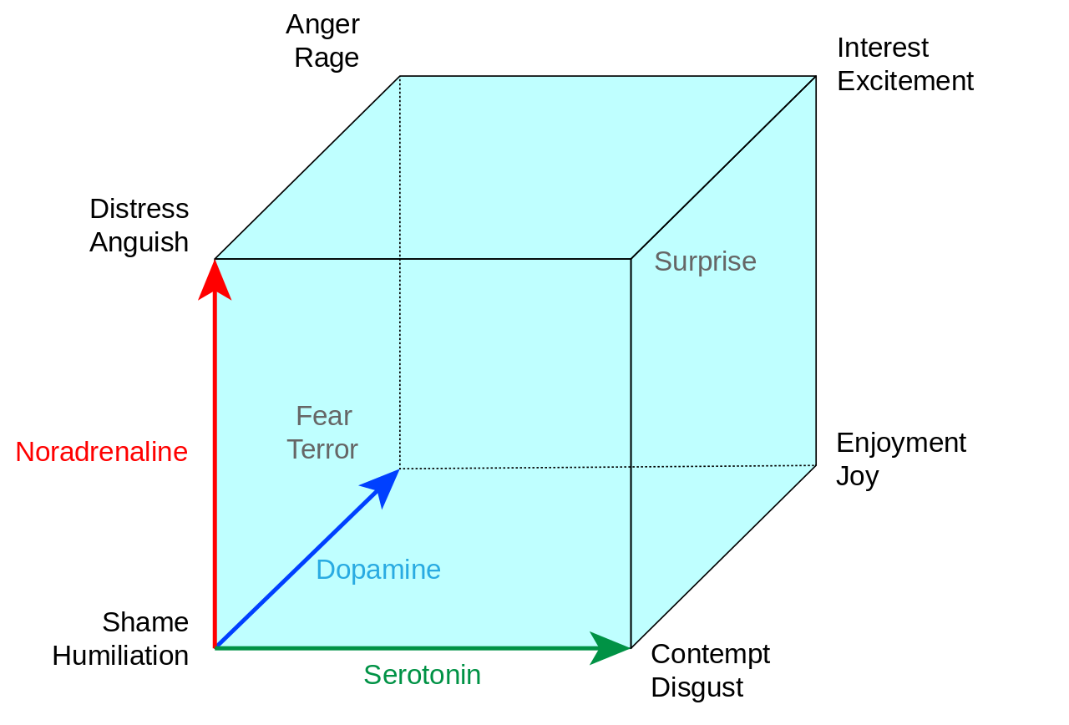
Models of emotion (IV)
Lövheim’s (2001) cube of emotion based on Tomkin’s 8 basic emotions (“Affect theory”):

Slide 51

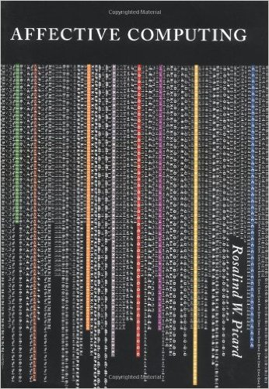
Affective computing
Rosalind Picard – MIT (1995)

Slide 52
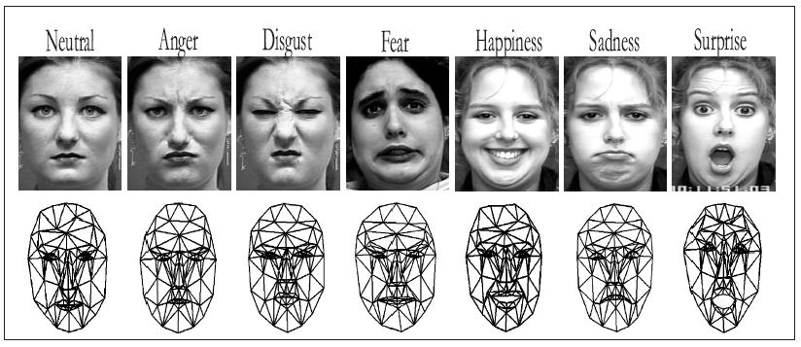
Emotion detection – Facial expression
Source: https://github.com/kylemcdonald/AppropriatingNewTechnologies/wiki/Week-2

Slide 53
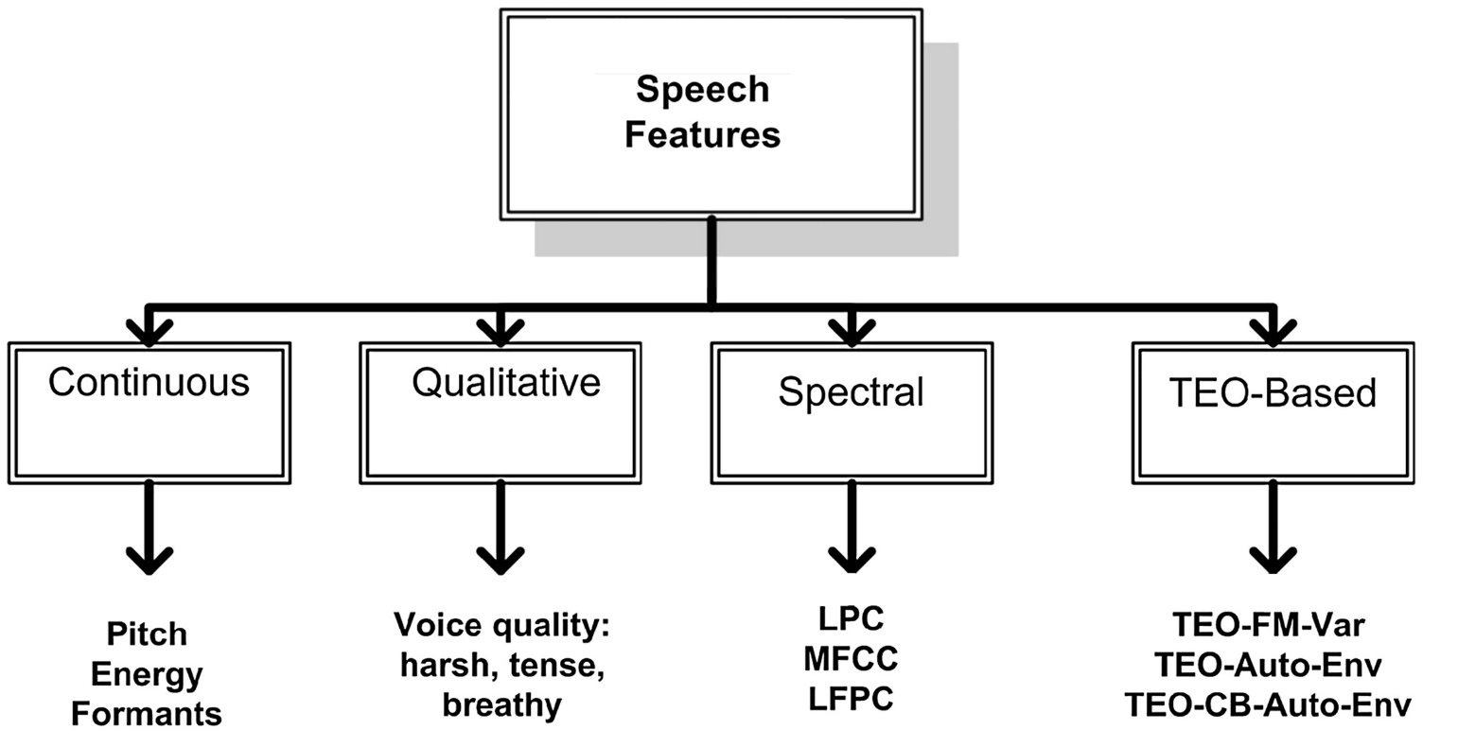
Emotion detection - Speech
Detecting frustration, anger – e.g. in virtual environments, answering machines

Slide 54
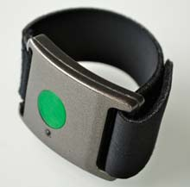
Emotion detection – Skin Conductance
Electrodermal activity (EDA), skin conductance, galvanic skin response (GSR), electrodermal response (EDR), psychogalvanic reflex (PGR), skin conductance response (SCR), sympathetic skin response(SSR) and skin conductance level (SCL) – (Boucsein, 2012)
Records physiological signs of stress and excitement by measuring slight electrical changes in the skin
Q sensor (MIT)
  Autistic children, people with affective disorders

Slide 55
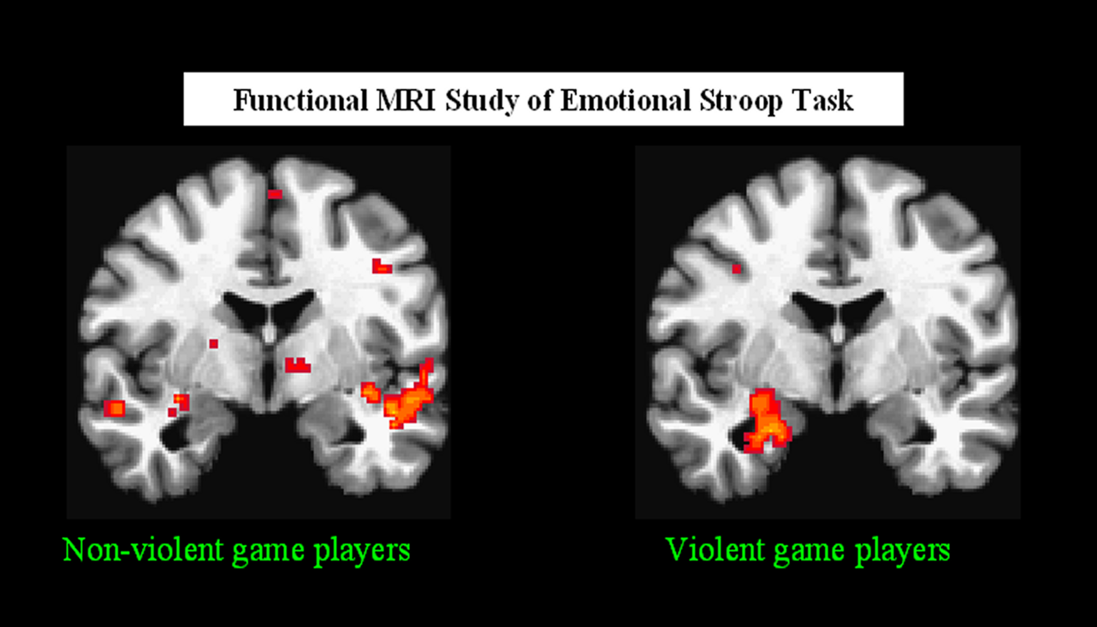
Emotion detection – fMRI Scans
Neural Representations of Language Meaning

Slide 56
Affect detection from text
The 3-component model:
What is the emotion the author is trying to convey?
What are possible emotional responses of the readers as a result of interpreting the meaning of the text?
What emotion is directly expressed in the text?

Slide 57
Affect detection from text
Bias detection, hate speech detection;humor detection, irony/sarcasm detection, opinion spam
The 3-component model:
? Recommendation, personalized content
Sentiment analysis/Opinion mining/Emotion detection & classification

Slide 58
Categories of emotion
Adapted from Gabrielsson (2002) – emotions in music
Expressed emotion: emotion the performer tries to communicate to the (readers)
Perceived emotion: emotion the reader perceives as being expressed
Felt (evoked) emotion: emotion felt by the reader, in response to text
And we can add: emotion directly present in the text

Slide 59
News bias detection
News bias is a complex process that comprises several dimensions to be taken into account; it is interlinked with social, political and economical problems (Hamilton, 2004)
specific choice of words and subtle structure of sentences can persuade the reader towards one point of view or another and are sufficient to influence whether people interpret violent acts as patriotism or terrorism (Dunn et al., 2012)
the usage of various parts of speech, like adjectives, adverbs and nouns and how these properties differ (Pollak et al., 2011)
Length of texts, headlines

Slide 60
Hate speech detection
“any communication that disparages a person or a group on the basis of some characteristic such as race, color, ethnicity, gender, sexual orientation, nationality, religion, or other characteristic.”(Nockleby, 2000)
“hatred against each different group is typically characterized by the use of a small set of high frequency stereotypical words”(Warner and Hirschberg, 2012)
Very little work done in this field
Also difficult to formally define the task, border freedom of spech:
  Detection using keyword frequency (Warner & Hirschberg, 2012)
  Using word embeddings and neural networks (Djuric et al., 2015)

Slide 61
Computational Humor Detection
Little work done here:
  Some work by Mihalcea and Strapparava (2005)
  Work by Stock and Strapparava (2003, 2005, 2006)

Slide 62
Sentiment Analysis – Opinion Mining
HOW DO PEOPLE REGARD “X”?
automatically extract from free text the “sentiment” expressed on a target X by a specific source and determine its “orientation” (positive, negative, etc. )
“I like the iPhone 6.” (product)
“The design of Apple products is great!” (brand)
“Lincoln was a very skilled leader.” (person)
Sentiment analysis in NLP
  Late 90’s, boost by Social Web - user-generated content
    Applications – social, economical, political
  Opinion mining, appraisal analysis, review mining, favourability analysis

Slide 63
General motivation
Helps companies, customers, public persons:
  Marketing, financial studies
  Choice of products
  Social media analysis
  Political view tracking & eRulemaking
  Election results prediction
  Policy making
  Trend analysis
Improves other NLP tasks:
  IE, QA, MPQA, summarization, authorship, WSD

Slide 64
Motivation of research (I)
1. Different goals of sentiment analysis:
  Good or bad news (Ku et al., 2005);
  Likes or dislikes (Pang et al., 2002);
  Candidate likely/unlikely to win (Kim and Hovy, 2005);
  Support/opposition (Bansal et al., 2008; Terveen et al., 1997) ;
  Pros and cons (Kim and Hovy, 2006);
  Improvement /death in medical texts (Niu et al., 2005);
  Agreement /disagreement with a topic (Malaouf et al., 2005);
  Arguments in favor or against a topic

Slide 65
Motivation of research (II)
65
1. Different goals of sentiment analysis:
  Good or bad news (Ku et al., 2005);
  Likes or dislikes (Pang et al., 2002);
  Candidate likely/unlikely to win (Kim and Hovy, 2005);
  Support/opposition (Bansal et al., 2008; Terveen et al., 1997) ;
  Pros and cons (Kim and Hovy, 2006);
  Improvement /death in medical texts (Niu et al., 2005);
  Agreement /disagreement with a topic (Malaouf et al., 2005);
  Arguments in favor or against a topic

Slide 66
Motivation of research (II)
66
2. Same methods for different text types
  Reviews, blogs, news, debates, forums, microblogs
3. Different goals → application:
  Percentual/text summaries
  Answer opinion questions
  General view of topics trends
  Recommendation

Slide 67
Motivation of research (III)
67
4. Multilinguality
  Resource scarcity
  Need to detect opinion (esp. Social media) in many languages
  Learning peculiarities of language
5. Most methods → direct sentiment expression
  Implicit sentiment (attitude) → author emotion
  Expressed by intentionality, meaning negotiation

Slide 68
Tasks and concepts definition (I) –
Subjectivity & Attitude
Subjectivity – Wiebe (1995)
  “private states” - feelings, emotions, goals, evaluations, judgments
Subjectivity analysis
  recognize subjective language, to distinguish it from descriptions of facts
  Attitude – AAAI 2004 Spring Symposium on Attitude
    “hypothetical construct that represents an individual's degree of like or dislike for something.” (Breckler and Wiggins, 1992)
    Attitude = {affect, judgment, appreciation}
    Used for speaker/author “intentionality”

Slide 69
Tasks and concepts definition (II) –
Sentiment analysis & Opinion mining
  Different definitions in the literature (tasks/terms)
    IE, IR, classification tasks
  “Nowadays many construe the term sentiment analysis more broadly to mean the computational treatment of opinion, sentiment and subjectivity in text.” (Pang and Lee, 2008)
  Sentiment ~ Opinion ~ Subjectivity
    Sentiment analysis = Opinion mining = Subj. analysis

Slide 70
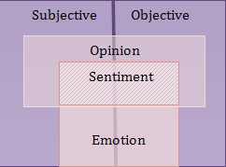
Tasks and concepts definition (III) - Proposal
De Sentiment ≠ Opinion ≠ Subjectivity
Opinion mining = Sentiment analysis ≠ Subjectivity analysis

Slide 71
State of the art
3 main research areas in SA:
  Creation of resources
    Lexical resources, annotation schemas, corpora
  Classification of text (document, sentence, word level)
    Lexicon-based, rule-based, supervised methods
  Opinion extraction (opinion, plus source and target)
    Rule-based, semi-supervised/supervised methods

Slide 72
Main research areas (I)
Creation of resources:
  Lexical resources for subjectivity/polarity (subjectivity, orientation, strength)
  Annotation schemes appropriate to each textual genre (news/blogs/product reviews)
  Corpora labeling for training and evaluation
    Some approaches use as gold standard already punctuated reviews (stars)

Slide 73
Methods to create lexicons for SA (I)
Study by Pang et al. (2006) - choose right 10 polarity keywords of a text –> A=60%
Seed adjectives – apply synonymy and antonymy in WN (Hu &Liu, 04)
Seed adjectives – use conjunctions/disjunctions to deduce orientation of new words & min-cut graphs (Pang & Lee, ’02; Hatzivassiloglou & McKeown, ‘97).

Slide 74
Methods to create lexicons for SA (II)
Terms with similar orientation tend to co-occur in documents (seed words + PMI using number of AltaVista returned results with NEAR)(Turney, ‘02)
Terms with similar glosses in WN tend to have similar polarity (Esuli & Sebastiani, ‘05)
Polarity anchors and NGD scores using training from pros/cons reviews (Balahur & Montoyo, ‘08)
Use polarity of local context, a weighting function of the words around (Popescu & Etzioni, ‘06)

Slide 75
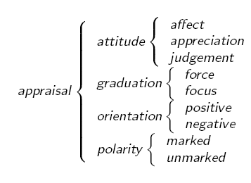
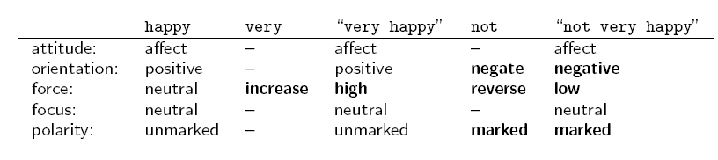
Appraisal Theory – in Linguistics
(Martin and White, 2005) – The Appraisal theory - a framework of linguistic resources which describe how writers and speakers express inter-subjective and ideological positions.
(Whitelaw, 2006) - 400 seed words ->1350 terms

Slide 76
Going Multilingual
Creating subjectivity/sentiment dictionaries for languages other than English
Steinberger et al.(2011) – Creating Sentiment Dictionaries via Triangulation
  Translation of an English sentiment lexicon to Spanish
  Manual cleaning of dictionary obtained
  Parallel translation of En and Sp lexicons to other languages
  New lexicons = intersection of common translation
  Good accuracy for new terms obtained

Slide 77
Existing resources (I)
Opinion & affect lexicons:
  WordNet Affect (Strapparava & Valitutti, 2004)
    http://wndomains.fbk.eu/wnaffect.html
  SentiWordNet(Esuli & Sebastiani, 2006; 2010)
    http://sentiwordnet.isti.cnr.it/
  MicroWNOp (Cerini et al., 2007; 2010)
  Subjectivity indicators (MPQA & al.) (Cardie et.al, 2003)
  Appraisal terms (Whitelaw, 2006)
  NRC Twitter lexicons (Mohammad et al,
    http://saifmohammad.com/WebPages/lexicons.html

Slide 78
Existing resources (II)
Manually created lexical resources:
Dictionary of Affect (Whissell)
  http://sail.usc.edu/dal_app.php
Affective Norms for English Words (Bradley & Lang)
  http://csea.phhp.ufl.edu/media.html
Harvard General Inquirer categories (Stone etc.)
  http://www.wjh.harvard.edu/~inquirer/
NRC Emotion Lexicon (Mohammad & Turney) http://saifmohammad.com/WebPages/lexicons.html
MaxDiff Sentiment Lexicon (Kiritchenko, Zhu, & Mohammad) http://saifmohammad.com/WebPages/lexicons.html

Slide 79
Existing resources (III)
Manually created lexical resources:
Dictionary of Affect (Whissell)
  http://sail.usc.edu/dal_app.php
Affective Norms for English Words (Bradley & Lang)
  http://csea.phhp.ufl.edu/media.html
Harvard General Inquirer categories (Stone etc.)
  http://www.wjh.harvard.edu/~inquirer/
NRC Emotion Lexicon (Mohammad & Turney) http://saifmohammad.com/WebPages/lexicons.html
MaxDiff Sentiment Lexicon (Kiritchenko, Zhu, & Mohammad) http://saifmohammad.com/WebPages/lexicons.html

Slide 80
Existing resources (IV)
Affective Text Dataset (Strapparava & Mihalcea) – news; headlines
  http://web.eecs.umich.edu/~mihalcea/downloads.html#affective
Affect Dataset (Alm) – classic literary tales; sentences
  http://people.rc.rit.edu/~coagla/
2012 US Presidential Elections – tweets (Mohammad et al.)
  http://saifmohammad.com/WebDocs/ElectoralTweetsData.zip
EmotionML (Schröder et al.)
  http://www.w3.org/TR/emotionml/
ISEAR (Scherer, 1997)
MPQA (Wiebe et al., 2002)
TAC/TREC data (2006-2008)
NTCIR MOAT data (2007-2010)
SemEval data:
  Sentiment Analysis in Twitter (2013-2016)
  Aspect-based Sentiment Analysis (2016)
  Detecting stance in Tweets (2016)
  Detecting sentiment intensity (2016)

Slide 81
Existing resources (V) – other languages
Spanish:
  TASS (Taller de Analisis de Sentimientos y Sujetividad)
  http://www.sngularmeaning.team/TASS2013/corpus.php
  Perez-Rosas Lexicon
  https://web.eecs.umich.edu/~mihalcea/downloads.html#SPANISH_SENT_LEXICONS
  iSOL (Molina-Gonzales et al., 2013)
Dutch:
  Framework for interpersonal communication (Vaassen & Daelemans, 2011)
  OpeNER http://www.opener-project.eu/documentation/
German:
  German polarity clues: http://www.ulliwaltinger.de/sentiment/
Chinese:
  2013 Chinese Microblog Sentiment Analysis Evaluation (CMSAE) Dataset of posts from Sina Weibo annotated with seven emotions:
  http://tcci.ccf.org.cn/conference/2013/pages/page04 eva.html
Japanese:
  Japanese customer reviews corpus with the same eight emotions used in the Chinese Ren-CECps Corpus (Sun et al., 2014)

Slide 82
General approaches (I)
Can be divided in three main categories (Pang & Lee, 2008; Medhat et al., 2014):
  Lexicon-based approaches
  Machine learning approaches
  Hybrid methods
Machine learning approaches:
  Supervised learning
    Decision tree classifiers
    Linear classifiers
    Rule-based classifiers
    Probabilistic classifiers
  Unsupervised learning

Slide 83
General approaches (II)
Lexicon-based approaches:
  Based on the lexicons we described before
  Words are associated a polarity score
  Overall polarity determined by summing up polarity scores
    Some rules regarding polarity modification by negators/intensifiers/diminishers

Slide 84
General approaches (III)
Machine learning approaches
  Supervised learning
    Based on annotated corpora
    Sentiment analysis as a classification problem (2-3-5 classes)
    “very negative”, “negative”, “neutral”, “positive”, “very positive”
    Using a plethora of algorithms:
      Naïve Bayes, Bayesian Network, Maximum Entropy
      Support Vector Machines, Neural Networks
      Decision Trees

Slide 85
General approaches (IV)
Pre-processing:
  Lemmatizing/Stemming and stop word removal (sometimes)
    Some might prove important (e.g. for, no, and, but, etc.)
  Text normalization (especially for microblog/SM texts, sms)
  POS-tagging and (sometimes) syntactic parsing, SRL
Features (BoW):
  Terms presence
  Terms frequency (tf-idf, etc.)
  Parts of Speech
  Presence of opinion words
  Presence of negators, intensifiers, diminishers
  N-grams of different sizes
Feature selection:
  PMI, Chi-square, LSI/LSA

Slide 86




Dealing with Multilinguality (I)
(Balahur and Turchi, 2012; 2013)
Machine translation systems – improved
  MT better than mot-a-mot translation with dictionaries
  Syntax, multi-word expressions, context
  Open/public access solutions – Moses, Google, Bing, Yahoo
  Good performance for widely-used languages
Can we use MT systems to translate test data to a language with resources?
And use training data in that language

Slide 87
Dealing with Multilinguality (II)
  Can we use MT systems to obtain training data in another language?
    To build a model to detect sentiment
    E.g. German, French, Spanish (not all similar)
  Use:
    English sentiment-annotated data
    3 translation systems: Moses, Bing, Google (+ Yahoo for GS)
    Different feature representations
    Different ML algorithms
    Meta-classifiers

Slide 88
Dealing with Multilinguality (III)
  Classify sentiment in text: positive, negative, neutral
  Different methods employed:
    Knowledge-based
      Large-enough lexica?
      Ambiguity (words with no context)
    Semi-supervised
      Use knowledge to classify small initial set + supervised methods
      Performance of initial set?
    Supervised
      SMT usage
      Study “noise” impact

Slide 89
Dealing with Multilinguality (IV)
  Data for English at NTCIR 8 MOAT (Multilingual Opinion Analysis Task)
    Sentences (6165)
    Opinion units (6223)
  Randomly selected 600 sentences – test set
  Rest training set – 5600 sentences
  Translate with Moses, Google, Bing
  Create Gold Standard per language:
    Manual correction of Yahoo translation
  Many neutral sentences – > only positive & negative
    Training: 943 examples (333 positive and 610 negative)
    Test set and Gold Standard: 357 examples (107 pos and 250 neg)

Slide 90
Dealing with Multilinguality (V)
Supervised learning using:
    Presence/absence (boolean) of :
      Unigrams
      Bigrams
      Unigrams+bigrams
    Tf-idf of :
      Unigrams
      Bigrams
      Unigrams+bigrams

Slide 91
Dealing with Multilinguality (VI)
Training on:
      Translations of each system/language
      Combined translations from all 3 MT systems
Testing on:
      Translations of each system/language
      Gold Standard
Using as algithms:
      SVM
      Meta-classifiers – Bagging & AdaBoost

Slide 92
Dealing with Multilinguality (VI)
Incorrect translation:
      Larger number of features, sparseness
      Features not informative
        Loss in performance
Comparative tables/language
      Max 12% loss SMO, Max 8% loss Bagging
      AdaBoost more than Bagging
      GS for training?
        More realistic

Slide 93
Dealing with Multilinguality (VII)
Noise in data:
      Translation errors + non-informative features
Manual inspection of data:
      German (lower quality) – tf-idf
      Better performance translation – uni+bi
      Cleaner data – uni+bi – > informative

Slide 94
Dealing with Multilinguality (VIII)
Extensive evaluation of MT for multilingual SA
      Reasonable level of maturity
      Good MT system – small drop in performance
      Maybe combine other heuristics
Translated data:
      Wrong translation => sparseness of features + noise
        Use of meta-classifiers
      Good translation => more data = better (Spanish)
  Future work:
      Different (more) features
        Sentiment, Synonyms, Skip-grams

Slide 95
Dealing with negation in SA (I)
(Wiegand, Balahur et al., 2010) – “A survey on the role of negation in sentiment analysis”
1. I like+ this new Nokia model.
2. I do [not like+] − this new Nokia model
3. Not only is this phone expensive but it is also heavy and difficult to use
4. [I do [not like+] − the design of new Nokia model] but [it contains some intriguing+ new functions].

Slide 96
Dealing with negation in SA (II)
Pang et al. (2002) – add artificial words to the typical BoW representation (NOT_x)
I do not NOT_like NOT_this NOT_new NOT_Nokia NOT_model.
(Polanyi & Zaenen, 2004), (Kennedy & Inkpen, 2005) – rules:
  Words have polarity values associated: clever (+2)
  Negation means value word *(-1) : not clever (-2)
(Moilanen and Pulman, 2007) – semantic composition using use syntactic phrase structure trees
Heuristic rules to model scope of negation (window size after negation word, first occurrence of polar expression, whole sentence) - Choi and Cardie (2008), Jia et al. (2009)

Slide 97
SA in different types of text
Reviews
Microblogs
Blogs
Newspaper articles
Political debates

Slide 98
SA in Reviews (I)
  “Bought this Lumix camera last week. Was totally impressed. It’s light as a feather. Picture colors are great. But it broke after 3 days.”
Issues:
  Feature-based OM and summarization
    “Aspect-based sentiment analysis”
  Products have features
    Find “features” of the object
  Classify opinion in feature-dependent manner
    E.g. huge screen vs. huge phone
  Implicit expressions of evaluation using affect
    E.g. “totally impressed”
  No corpora annotated accordingly

Slide 99
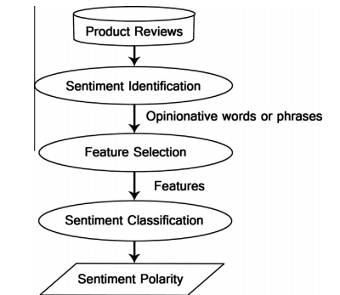
SA in Reviews (II)
(Mehmet et al., 2014)

Slide 100
SA in Reviews (III) – Feature extraction
(Hu and Liu, 2004; Liu et al., 2005)
A frequency-based approach (Hu and Liu, 2004):
  nouns (NN) that are frequently talked about are likely to be true aspects (called frequent aspects) .
Sequential/association pattern mining finds frequent nouns and noun phrases.
Infrequent features/aspects extracted using opinion target
  approximated with the nearest noun to the opinion word
  generalized to dependency in (Zhuang et al 2006) and double propagation in (Qiu et al 2009;2011)

Slide 101
SA in Reviews (IV)
(Popescu and Etzioni, 2005)
Improved (Hu and Liu, 2004) removing frequent noun phrases that may not be aspects
Identifies part-of relationship
Each noun phrase is given a pointwise mutual information score between the phrase and part discriminators associated with the product class, e.g., a camera class.
  E.g., “of camera”, “camera has”, etc.
    used to find parts of cameras by searching on the Web
(Balahur and Montoyo, 2008)
  Added technical features specifications from webs

Slide 102
SA in Microblogs (I)
Microblogs = Twitter (mostly)
140 characters, use of hashtags (#) for topic, (@) for users
Much info in a short text
  loss in grammar, spelling, lots of acronyms, short forms
Use of specific markers for sentiment (caps, repeated letters)
Use of slang and special graphical signs (emoticons)
High rate of data production -> high speed in processing
E.g. Twitter available in over 30 languages, tweets in more than 80 languages -> highly multilingual
“said it b4 dat gucci been promoting his mixtape 2 drop on 10/17 since august, Gotti just up & tried 2 come out on da same date”
@Hollyhippo voy a mañana blockbuster para obtener Devil Inside si te parece bien? ;)

Slide 103

SA in Microblogs (II)
Three types of methods used:
Dictionary-based (knowledge-based)
  Words that carry a sentiment have polarity value assigned
  E.g. “happy” has a value of 2, “sad” has a value of -2
Statistical/supervised (using machine learning)
  Based on examples
  E.g. if “I like roses” is positive, then “I like lilies” is also positive
Hybrid – supervised learning with special features
  Abstract on features – “happy”, “excited”, “joyful” – all grouped under “POSITIVE”

Slide 104
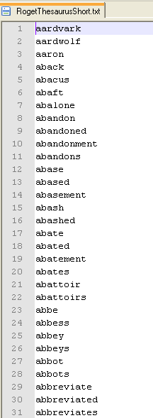
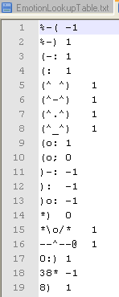
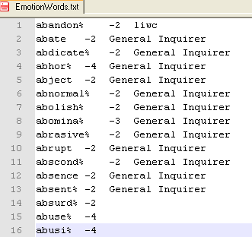
SA in Microblogs (III)
Word normalization
  words search in Roget’s Thesaurus
  eliminate repeated letters dictionary word matched
    E.g. “Perrrrrrrrrrrrrrrrrrfect”
Emoticon replacement
  emoticon list matching
  Replace with word and its value
Affect word matching
  The words were matched against the affect lexicons:
Repeated punctuation sign normalization (!!!)

Slide 105
SA in Microblogs (IV)
SemEval Sentiment Analysis in Twitter competition
(Nakov et al., 2013, Rosenthal et al., 2014, Rosenthal et al., 2015, Nakov et al., 2016):
Different approaches, relying on
    Classifiers:
      SVM, MaxEnt, and Naive Bayes
    Lexicons of opinion words:
      MPQA, SentiWordNet, Bing Liu’s opinion lexicon, NRC lexicon (Mohammad et al., 2013)

Slide 106
Sentiment Analysis in Political Debates
Debates:
  Dialogue-like structure
  Multiple opinion sources
  References to previous speakers, arguments
  Opinions on topic, but also other speakers
  Known topic – law/bill/proposal…

Slide 107
Sentiment Analysis in Political Debates
Test a general method for opinion classification
Classify opinion independently of target?
Method to determine the source of the opinion expressed
  based on the attitude of the speaker on the topic (association to opinion words)
(Balahur et al., CICLING 2009)

Slide 108
Sentiment Analysis in Political Debates -

Slide 109
Sentiment analysis in the News
Newspaper articles:
  Long pieces of text
  Various sources of opinion
  Multitude of topics discussed
  Mixture of direct opinions with event descriptions
  Factual descriptions not necessarily lack sentiment
  Source bias, apparenting objectivity, implicit appraisals

Slide 110
Sentiment analysis in the News-Contributions (I)
First approach - document level sentiment analysis, using sentiment dictionaries (high multilinguality)
  High positives – Positives – Negatives – High Negatives
  What does it mean?
Sentiment analysis in quotations (reported speech)
  Shorter, more focussed
  Sentiment explicit
3 types of experiments – 100 quotes (Balahur et al., WIIAT 2009):
  Compare different resources in a bag-of-words classification
  Compute quotes’ similarity with sentences from the ISEAR corpus (7 emotion categories)
  Train SVM classifier on EmotiBlog corpus

Slide 111
Sentiment analysis in the News –
Contributions (II)
Much lower results than for debates – why?
When trying to produce a larger annotated gold standard collection:
  Inter-annotator agreement is low (<50%)
New annotation (Balahur & Steinberger, WOMSA 2009):
  Separate good vs. bad news
  Only sentiment expressely stated on the entity target
  No world knowledge, interpretation
  Agreement – 1582 quotes - 81% among 3 pairs of 2 annotators

Slide 112
Sentiment analysis in the News - Conclusions
Inter-annotator agreement very low → task is badly defined
What is sentiment analysis in the news?
  Need to define target and source
  Separate good and bad news from opinion on target
  Annotate only clearly marked opinion
    Linked to 3 views on articles: author, reader, text
  Last experiments (Balahur et al, 2010 LREC) – up to 82% accuracy (3-class labeling)
  Collection extended with 2357 quotes in German

Slide 113
Sentiment analysis in blogs
Blogs:
  Informal style
  Mixture of newspaper articles, comments
  Multiple opinion sources
  Multiple opinion targets
  Anaphoric mentions at a cross-post level

Slide 114
Sentiment analysis in blogs - EmotiBlog
Collection of a corpus in three languages:
    Italian
    Spanish
    English
  30.000 words for each language and topic
About three topics:
    The Kyoto Protocol
    The elections in Zimbabwe
    The USA elections
Annotations for:
  Words + multi-word expressions + sentence level
  Polarity + intensity + emotion
(Boldrini, Balahur, Martínez-Barco, Montoyo - DMIN 2009)

Slide 115
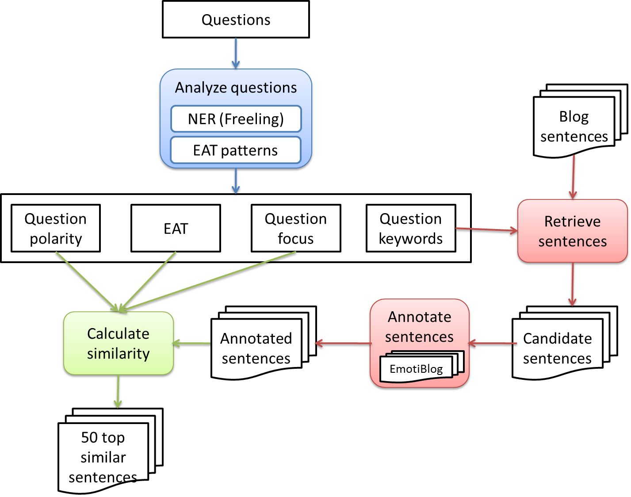
Opinion QA from blogs

Slide 116
Implicit sentiment detection – Issues
NLP – sentiment analysis as classification task – ML, lexica
  “The kitten climbed into my lap.” →“kittens are cute”
  “The pig climbed into my lap.” → “pigs are dirty”
  “The dog started barking as I approached.” → “bark – maybe bite?”
  “The dog started wagging its tail as I approached.” → “wagging – happy”
  “The man killed the mosquito.” → “mosquito –bothering insect”
  “The man killed the woman.” → “woman – person; against law”
  “I’m going to a family party because my mother obliges me to.”
Polarity of the sentiment depends on the characteristics of the actor, action or object of event (small lex. differences)

Slide 117
Implicit sentiment detection - Emotion triggers
What is said explicitly in the text vs. what is intended
Values authors appeal to/readers interpret
“Emotion trigger” - word or idea that:
is connected to general human needs and motivations
depends on the reader’s interests, cultural, educational and social factors
relates to general human needs and motivations
leads to an emotional interpretation of a given text. (e.g. “war”, “hunger”, “job loss”) (Balahur et al., AISB 2008)

Slide 118
Implicit sentiment detection –
Emotion triggers lexical database (I)
Based on 3 theories:
  Theory of relevance (Sperber and Wilson, 2000)
  Maslow’s pyramid of human needs and motivations
  Max-Neef’s matrix of human needs
For English and Spanish:
  Core of terms - English
  Expand with: WordNet , Nomlex
  Mapped to Spanish (EuroWordNet)
  Extended to culture-dependent terms – ConceptNet, LIDSL
Evaluated on SemEval 2007 Task 14 data (Balahur and Montoyo, AISB 2008)
  Good results
  Need more world knowledge – lexica not enough
  More thorough criteria for “emotion triggering”

Slide 119
Implicit sentiment detection - Appraisal theories
Emotions are elicited and differentiated on the basis of the subjective evaluation of the personal significance of a situation, object or event (criteria).
  (De Rivera, 1977; Frijda, 1986; Ortony, Clore and Collins, 1988; Johnson-Laird and Oatley, 1989)

Slide 120
Implicit sentiment detection – EmotiNet (I)
Propose a method for modelling affective reactions based on the Appraisal Theories → EmotiNet KB:
  Situations = Action chains + Properties (WK)
  Extract appraisal criteria
  “I’m going to a family party because my mother obliges me to.”
    Action chain: (I, go, family party) , (mother, oblige, me)
    Appraisal criteria:
      significance to personal goals → frustration, anger

Slide 121
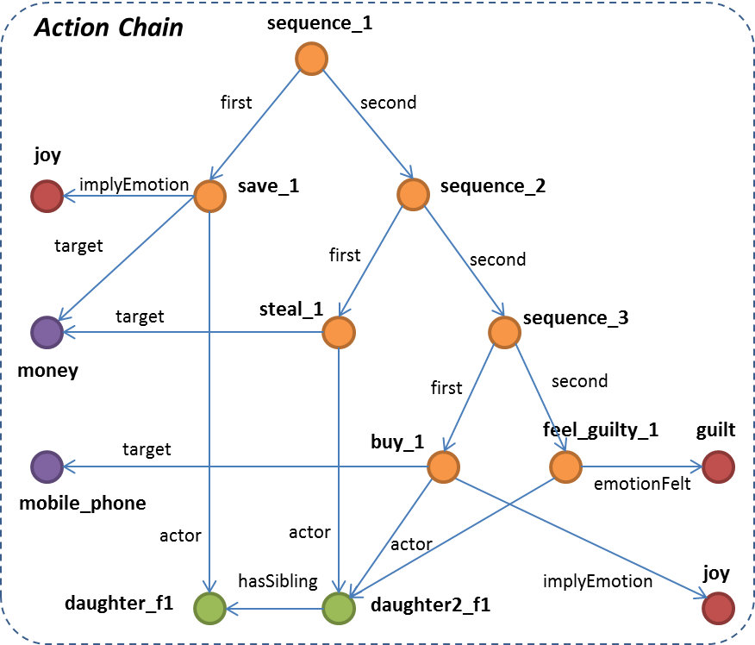

Slide 122
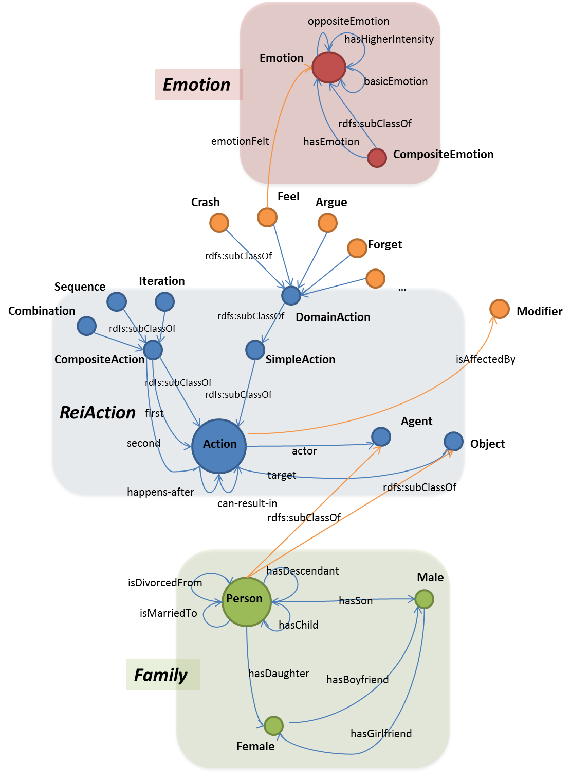

Slide 123
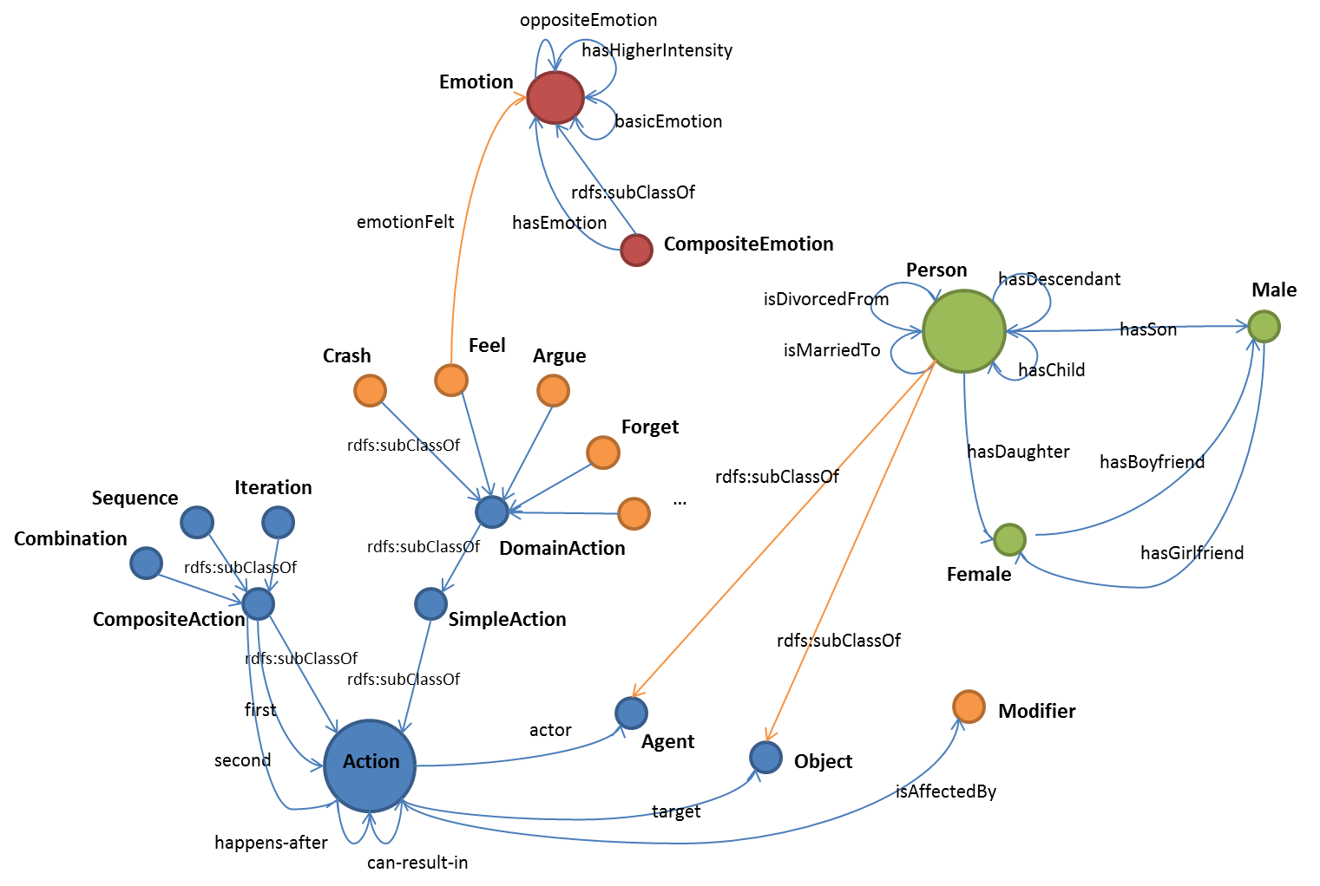

Slide 124
SA and other NLP Tasks
Opinion Retrieval and Question Answering
  MPQA corpus
  TAC 2008 Opinion Pilot
    Given a set of questions of the type
    Why do people like George Clooney?
    Find all the pieces of text from a set of blog posts that answer this question
Opinion Summarization
  Summarize the opinions people express on George Clooney
  Summarize the pros and cons expressed about Starbucks

Slide 125
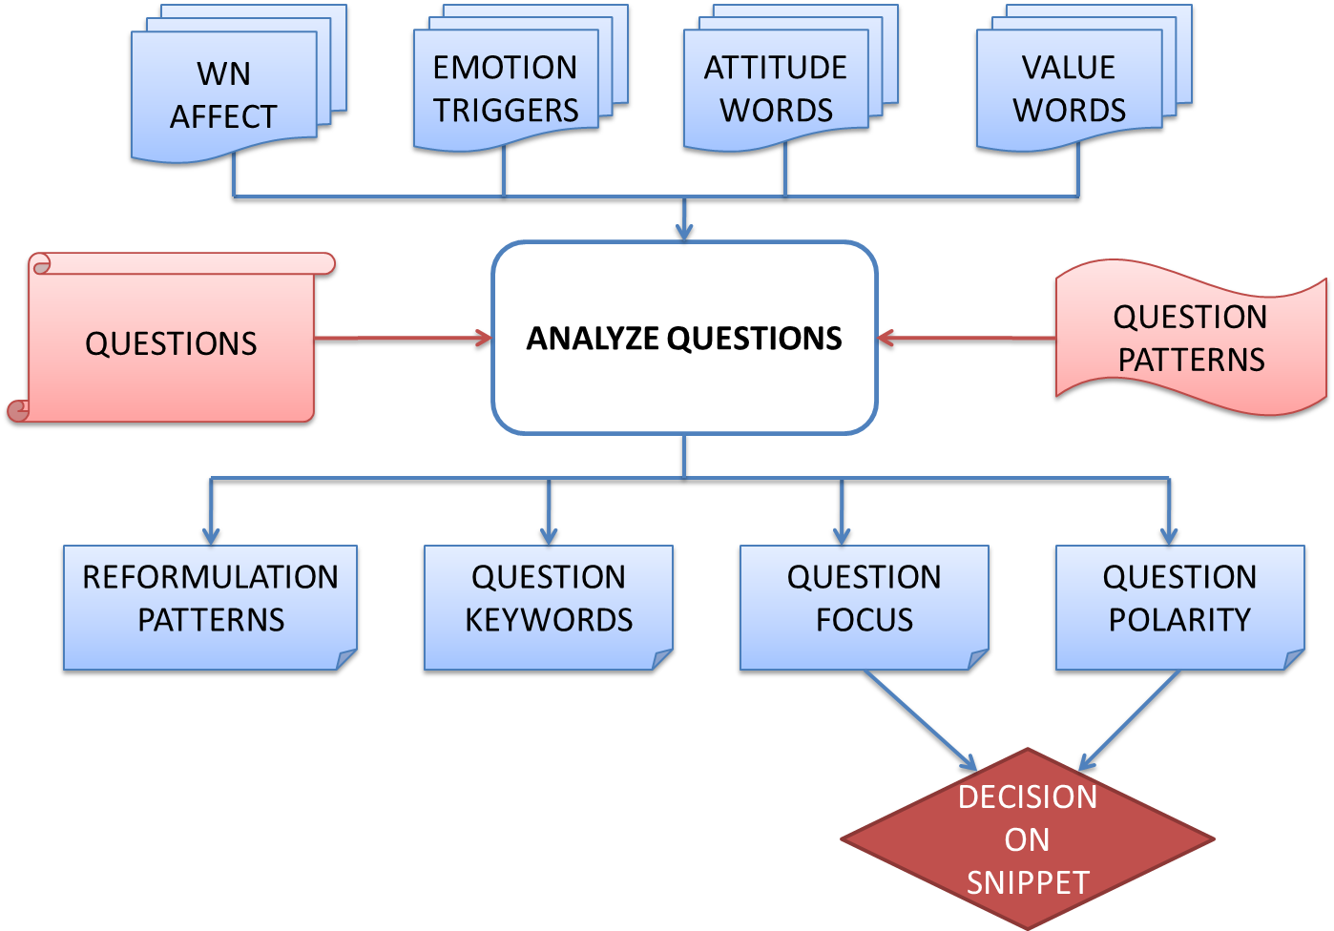

Slide 126
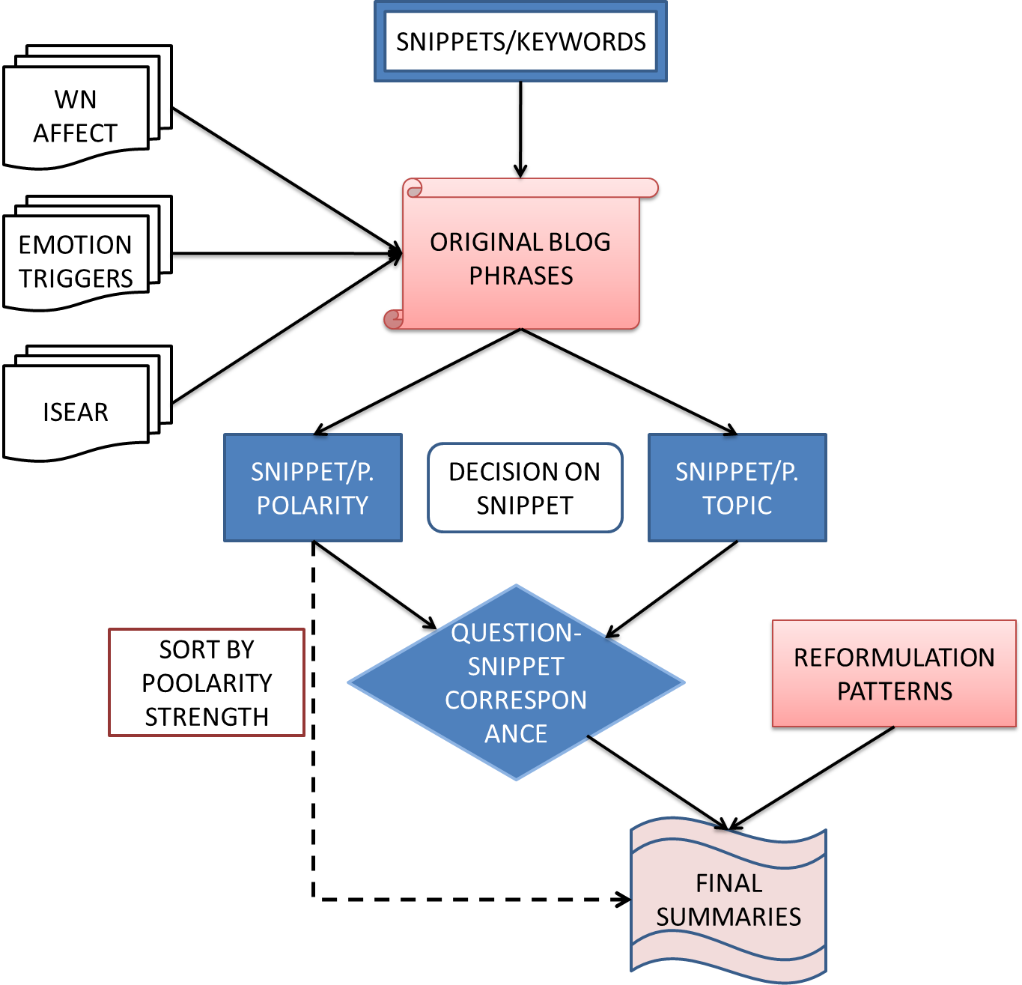

Slide 127
Competitions
TAC 2008 Opinion Pilot
SemEval 2007 Affect in Text
SemEval 2013-2016 Sentiment Analysis in Twitter
NTCIR-MOAT series
SemEval 2016 Detecting Stance in Tweets
SemEval 2016 Aspect-based Sentiment Analysis
SemEval 2016 Determining Sentiment Intensity in of English and Arabic Tweets
TASS (Taller de Analisis de Sentimientos y Sujetividad) 2013-2016

Slide 128
Remaining challenges
Definition of a unified framework for sentiment analysis
Task description in a general, yet consistent manner across genres and applications
3 components: author, text, reader
  Speech acts, appraisal, appraisal criteria
  Source bias, reader background
Linking “world knowledge” – CYC, SUMO, etc.
  Dependency to culture, social and moral norms
User preferences, social + personal values

Slide 129
Applications of SA
Interactive
http://text-processing.com/demo/sentiment/
http://nlp.stanford.edu:8080/sentiment/rntnDemo.html
http://demo2-opener.rhcloud.com/welcome.action
https://www.lexalytics.com/demo
http://www.citizenandscience.eu
http://www.alchemyapi.com/products/demo
https://www.csc.ncsu.edu/faculty/healey/tweet_viz/tweet_app/

Slide 130

Other applications

Slide 131
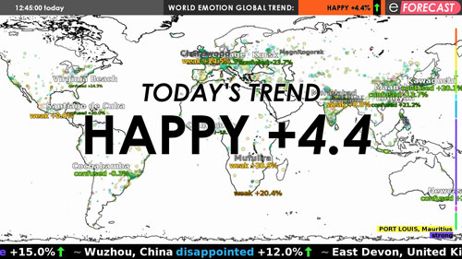
Other applications

Slide 132
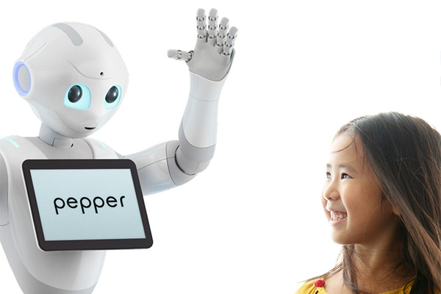
Other applications

Slide 133
Conclusions?
…

